Slide 1
The Future of Rockbuster Stealth
By Saswata Biswas

Slide 2
Objective
To launch an online video rental service with existing movie licenses.
Key Questions
Which movies contributed the most/least to revenue gain?
What was the average rental duration for all videos?
Which countries are Rockbuster customers based in?
Where are customers with a high lifetime value based?
Do sales figures vary between geographic regions?

Slide 3
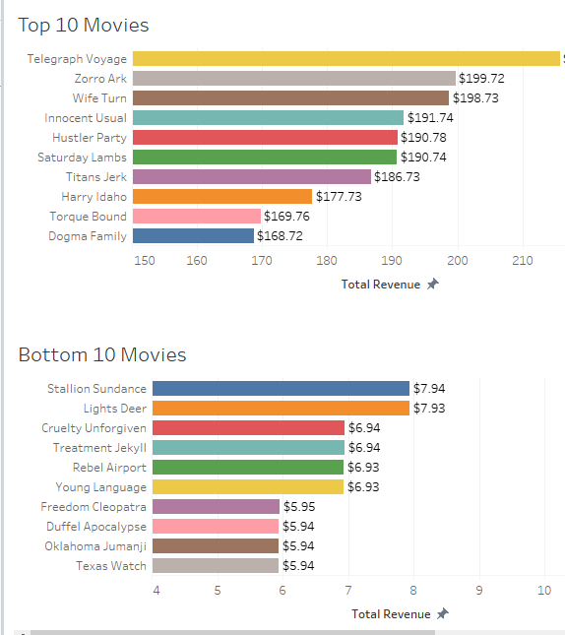
Movies with most and least revenue
1000 movies available
42 movies did not generate any revenue

Slide 4
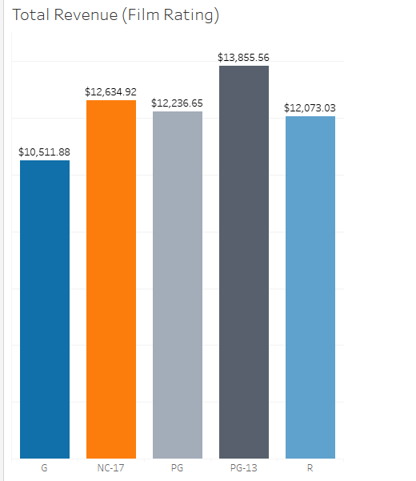
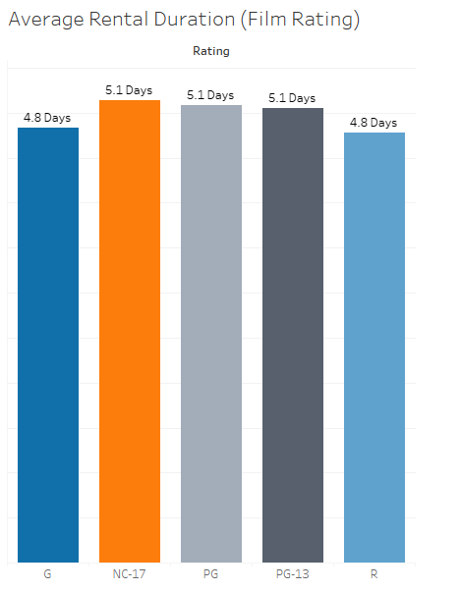
Key details of Rockbuster Film Library
Average Rental Duration | 4.985
Minimum Rental Duration | 3
Maximum Rental Duration | 7

Slide 5
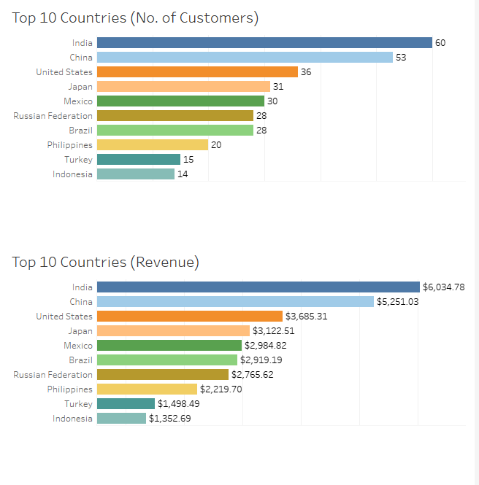
Which countries are Rockbuster customers based in?
Total number of customer – 599
Total number of Countries – 108
Revenue generated is directly proportional to the number of customers in a country

Slide 6
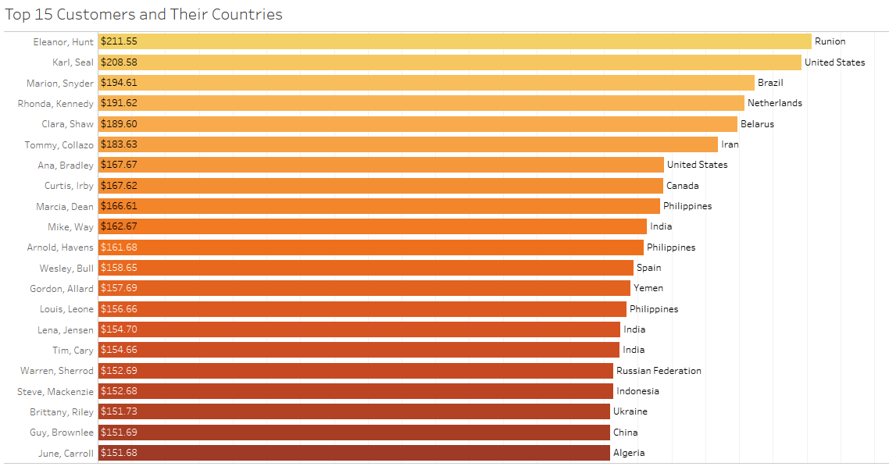
Most of the top 15 Customers are in the top 10 revenue generating countries

Slide 7
Recommendations
Remove movies that have not generated any revenue
Allocate marketing budget in the top 10 countries
Create customized marketing strategies and loyalty programs for high-value customers, and attract mid-tier customers with specific promotions and incentives
Advertise the availability of most popular movies
Get films that are released after 2006 as well

